Slide 1
Emotion Cause extraction
using graphs to capture the flow of the conversation
Group 21

Slide 2
Team
Name- Aishez Singh
Roll no.- 2101CS06
Name- Abhijeet Kumar
Roll no.- 2101CS02
Name- Hariomkant sharma
Roll no.- 2101CS31

Slide 3
Goal of project
The goal of the assignment is to extract emotion-cause pairs from conversations using graphs to model the flow of dialogue.
The process involves three main tasks:
dataset preparation
annotation
model development

Slide 4
Tools & Libraries used
NLP: SpaCy, NLTK, Hugging Face Transformers (for parsing & embeddings).
Graph Construction: NetworkX.
Graph Learning: PyTorch Geometric.
Data Handling: Pandas.
Visualization: Matplotlib (for optional graph plots).

Slide 5
Task 1: Dataset preparation

Slide 6
Task 1: Dataset preparation
The objective of this task is to preprocess the RECCON dataset by extracting meaningful clauses from each utterance in the conversation data.
This involves loading and combining data from RECCON dataset, then spliting utterances into clauses based on punctuation and conjunctions. The resulting clauses, along with relevant metadata are structured and saved into a CSV file.

Slide 7
1. Understand the Dataset
Dataset: RECCON (Recognition of Emotion Cause in Conversations).
Content: Each file contains conversations labeled by conversation ID (tr_xxxx), and each conversation consists of multiple utterances.
Goal: Extract meaningful clauses from each utterance for downstream processing (e.g., emotion-cause analysis).

Slide 8
2. Break Utterances into Clauses
Objective: Split long utterances into smaller, meaningful clauses.
Method:
Use punctuation marks (?, ., !) and coordinating conjunctions (and, but, or) as delimiters.

Slide 9
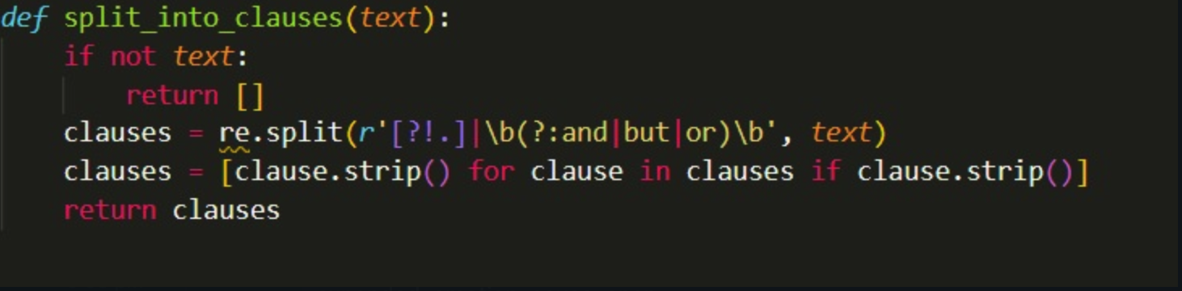
3. Automate Clause Extraction
Tools Used:
regex (Regular Expressions) for rule-based splitting.
Function:
Removes empty strings.
Trims whitespace.
A simple and fast approach suitable for initial clause extraction.

Slide 10
4. Process and Combine Data
Loading: All JSON files (train, test, valid) are loaded using json.load().
Combining: Merged using Python’s dictionary unpacking ({**train_data, **test_data, **val_data}).
Iteration:
For each utterance in every conversation:
Apply split_into_clauses.
Extract metadata like turn, speaker, emotion, cause evidence/span.
Store in a structured format.

Slide 11
5. Save Results
Format: Structured as a pandas DataFrame.
Output File: combined_data_with_clauses.csv.
Fields:
conversation_id
turn
speaker
utterance
clauses (list of extracted clauses)
emotion
expanded_emotion_cause_evidence
expanded_emotion_cause_span
type

Slide 12
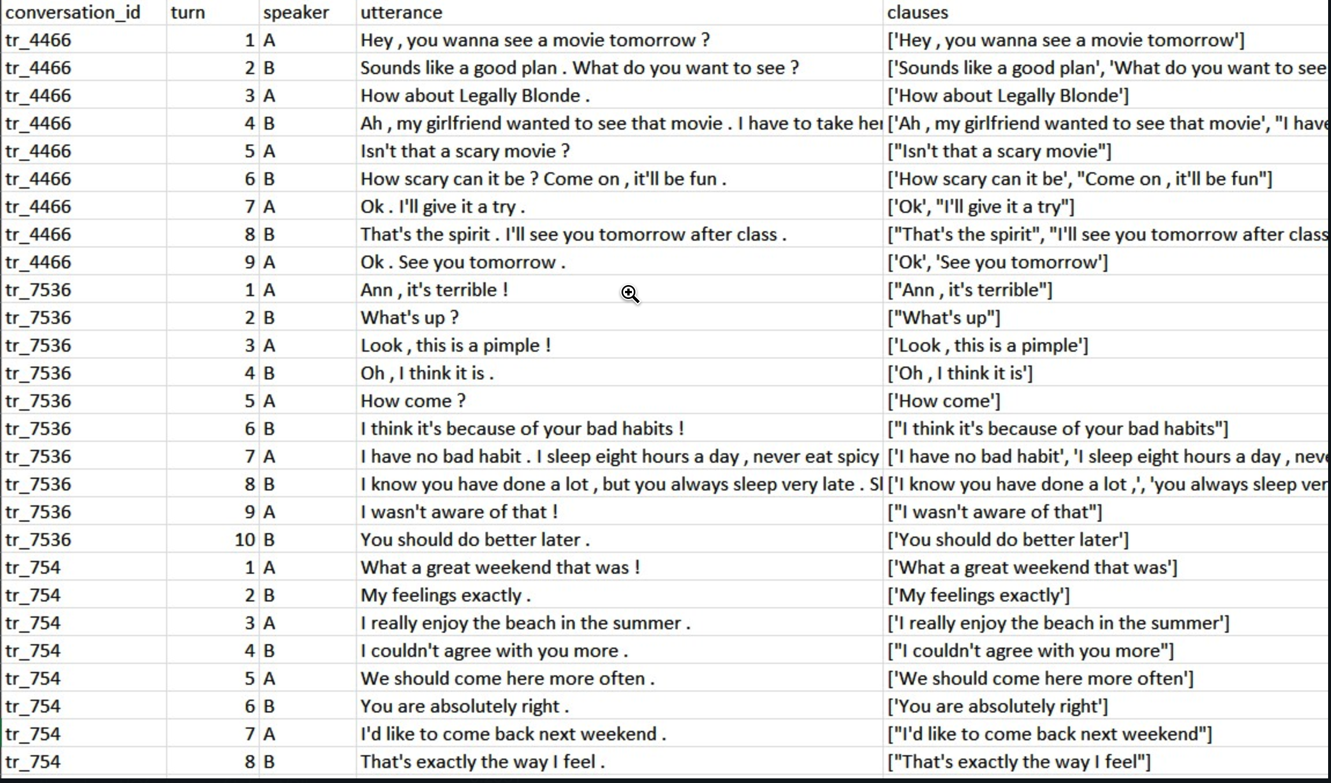
combined_data_with_clauses.csv

Slide 13
Task 2 : Annotation

Slide 14
Task 2 : Annotation
Objective:
To automate the annotation of clauses in the RECCON dataset as emotion, cause, or none.

Slide 15
Label Clauses
Goal: Annotating each clause as:
Labels used for classification:
"emotion clause", "cause clause", "neutral clause"
Mapping each clause to a label using available metadata (type field), expanded list of emotion-related keywords and a pretrained emotion classifier: MoritzLaurer/deberta-v3-base-zeroshot-v1.

Slide 16
Defines an expanded list of emotion-related keywords (e.g., "happy", "scared", "i'm sad”)
Checks if any emotion keyword is in the clause
If not found, applies zero-shot classification
Score-based decision rules:
Emotion clause if score ≥ 0.5
Cause clause if score ≥ 0.3
Otherwise, neutral clause

Slide 17
Processing the Dataset
Iterates through each conversation entry
For each turn:
Classifies each clause
Final result is updated csv file with emotion - cause annotation along with other metadata of each clause.

Slide 18
Task 3 : Model development

Slide 19
Task 3 : model development
Objective:
To construct a clause-level graph with labeled nodes and sequential edges for use in emotion-cause relationship modeling and develop a GraphSAGE-based model that learns from clause-level graphs constructed from conversations, using semantic embeddings and sequential relationships, to classify each clause as emotion, cause, both, or none, and evaluate the model's performance using standard classification metrics.

Slide 20
Embeddings
Approach:
- Using sentence-transformer (MiniLM-L6-v2) to encode clause embeddings.

Slide 21
Graph Construction
Node : Each clause becomes a graph node.
Node features: clause embeddings.
Node labels: emotion/cause labels based on type mapping.
Edges:
- Sequential: Connect adjacent clauses within the same conversation.
Building bidirectional sequential edges between clauses in the same conversation.
Semantic: Based on subject-verb-object (SVO) relations via dependency parsing.

Slide 22
Graph Construction
Graph Representation:
Use PyTorch Geometric’s Data class.
Fields: x (embeddings), y (labels), edge_index (graph structure).

Slide 23
GraphSAGE Model Implementation
A 2-layer GraphSAGE neural network is defined using torch_geometric.nn.SAGEConv.
Forward Pass:
Node features are passed through GraphSAGE layers with ReLU activation.
Training:
Optimizer: Adam with learning rate 0.01.
Loss: Cross-entropy based on ground truth labels.
Epochs: 200 (adjustable).
Output: Model predictions per node (emotion, cause, both, or none).

Slide 24
Results:
Epoch | 000, | Loss: | 1.7797, | AUC: | 0.4937, | Precision: | 0.0767, | Recall: | 0.1673, | F1 Score: | 0.0299
Epoch | 020, | Loss: | 1.1917, | AUC: | 0.6734, | Precision: | 0.2875, | Recall: | 0.2235, | F1 Score: | 0.1981
Epoch | 040, | Loss: | 1.1097, | AUC: | 0.7355, | Precision: | 0.2740, | Recall: | 0.2599, | F1 Score: | 0.2531
Epoch | 060, | Loss: | 1.0357, | AUC: | 0.7861, | Precision: | 0.3302, | Recall: | 0.2851, | F1 Score: | 0.2808
Epoch | 080, | Loss: | 0.9530, | AUC: | 0.8281, | Precision: | 0.4490, | Recall: | 0.3174, | F1 Score: | 0.3184
Epoch | 100, | Loss: | 0.8598, | AUC: | 0.8645, | Precision: | 0.5222, | Recall: | 0.3602, | F1 Score: | 0.3703
Epoch | 120, | Loss: | 0.7639, | AUC: | 0.8949, | Precision: | 0.6874, | Recall: | 0.4070, | F1 Score: | 0.4277
Epoch | 140, | Loss: | 0.6761, | AUC: | 0.9187, | Precision: | 0.7160, | Recall: | 0.4541, | F1 Score: | 0.4870
Epoch | 160, | Loss: | 0.5952, | AUC: | 0.9389, | Precision: | 0.7431, | Recall: | 0.5069, | F1 Score: | 0.5475
Epoch | 180, | Loss: | 0.5185, | AUC: | 0.9554, | Precision: | 0.7863, | Recall: | 0.5643, | F1 Score: | 0.6128

Slide 25
Final scores:
Final Accuracy: 0.8557
Final AUC: 0.9681
Final Precision: 0.8242
Final Recall: 0.6199
Final F1 Score: 0.6743

Slide 26
Code demo link
https://drive.google.com/file/d/1XlBdeHLQqjGT0YK4zXWnMTZKa9ZV5Swo/view?usp=sharing

Slide 27
Thank you

